Slide 1
DATA TYPES
In program in any language, we need to use various variables to store various information.
Variables are nothing but reserved memory locations to store values.
This means that when you create a variable you reserve some space in memory.

Slide 2
We have to store information of various data types like character, wide character, integer, floating point, double floating point, boolean etc.
Based on the data type of a variable, the operating system allocates memory and decides what can be stored in the reserved memory.

Slide 3
Primitive Built-in Types
Type | Keyword
Boolean | bool
Character | char
Floating point | float
Double floating point | Double floating point
Valueless | void
Wide character | wchar_t

Slide 4
The size of variables might be different from those shown in the above table, depending on the compiler and the computer you are using.
Program
#include <iostream>
using namespace std;
int main()
{
cout << "Size of char : " << sizeof(char) << endl;
cout << "Size of int : " << sizeof(int) << endl;
cout << "Size of short int : " << sizeof(short int) << endl;
cout << "Size of long int : " << sizeof(long int) << endl;
cout << "Size of float : " << sizeof(float) << endl;
cout << "Size of double : " << sizeof(double) << endl;
cout << "Size of wchar_t : " << sizeof(wchar_t) << endl;
return 0;
}

Slide 5
typedef Declarations
We can create a new name for an existing type using typedef.
Syntax:
typedef type newname;
Example Code:
typedef int feet;

Slide 6
Enumerated Types
Each enumerator is a constant whose type is the enumeration.
Creating an enumeration requires the use of the keyword enum.
Syntax:
enum enum-name { list of names } var-list;

Slide 7
For example, the following code defines an enumeration of colors called colors and the variable c of type color.
enum color { red, green, blue } c;
c = blue;

Slide 8
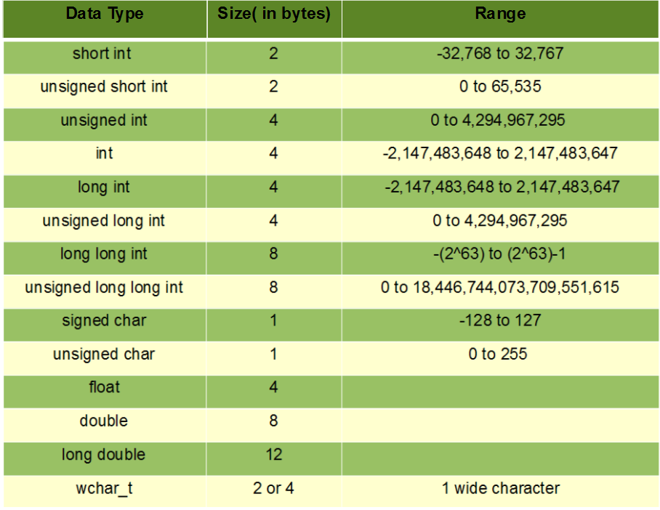
Memory For DataTypes

Slide 9
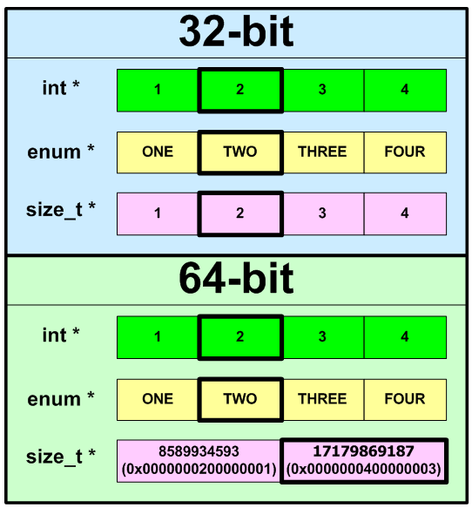
Memory Allocation

Slide 10
VARIABLES
A variable provides us with named storage that our programs can manipulate.
Each variable in C++ has a specific type, which determines the size and layout of the variable's memory; the range of values that can be stored within that memory;
Enumeration, Pointer, Array, Reference, Data structures, and Classes.

Slide 11
Variable Definition in C++
A variable definition tells the compiler where and how much storage to create for the variable.
Syntax:
type variable_list;
Programatic:
int i, j, k;
char c, ch;
float f, salary;
double d;

Slide 12
Variable Declaration in C++
A variable declaration has its meaning at the time of compilation only, compiler needs actual variable declaration at the time of linking of the program.

Slide 13
Program
#include <iostream>
using namespace std;
// Variable declaration:
extern int a, b;
extern int c;
extern float f;
int main ()
{
// Variable definition:
int a, b;
int c;
float f;

Slide 14
// actual initialization
a = 10;
b = 20;
c = a + b;
cout << c << endl ;
f = 70.0/3.0;
cout << f << endl ;
return 0;
}

